Slide 1
Reading Workshop
Soundswrite Phonics
Friday 16th September 2022

Slide 2
Importance of Teaching Reading
Reading is a gateway to lifelong learning
Reading brings enjoyment and enriches both learning and life
National Curriculum (KS1 and EYFS) talks about SKILLS and ENJOYMENT

Slide 3
Reading Skills Simple View = Word Recognition + Comprehension

Slide 4
Soundswrite is an effective linguistic phonics programme – it builds on the knowledge children have already acquired through listening and talking. A sounds to print approach, not a print to sounds approach! Children make or say sounds which are represented in print. Letters don’t make or say sounds they only represent them. It is a DFE Validated Systematic Synthetic Phonics Programme complying with 2021 guidance. https://www.sounds-write.co.uk/page-96-video.aspx
Letters and Sounds
Soundswrite Phonics
Notes:
NOTE: To change images on this slide, select a picture and delete it. Then click the Insert Picture icon in the placeholder to insert your own image.

Slide 5
What Soundswrite teaches…
Conceptual Knowledge
1.Letters are symbols (spellings) that represent sounds.
2. A sounds may be spelled by up to 4 letters e.g. dog dough
3. The same sound can be spelled in more than one way e.g. rain, stay
4. Many spellings can represent more than one sound
e.g. head, seat, break
Skills
Blending – pushing sounds together to build words
Segmenting – pulling apart sounds in words
Manipulating Sounds - inserting the right sound into a word or deleting the wrong sound
e.g. Knowing how to change pig to pit or map to mop

Slide 6
How the programme is organised
Initial Code
11 units of learning
Children gain confidence in blending, segmenting and manipulating sounds in words with a structure
from CVC to CCVCC, CVCCC and CCCVC words – 3 adjacent consonants, 5 sound words
Year R and Year 1
Extended Code
50 units of learning
Children extend their knowledge of blending, segmenting and manipulating sounds in multi syllable words,
investigating the same sound in different spellings and the same spelling but different sound
Year 1 and Year 2

Slide 7
Soundswrite Phonics Session Taster
Word Building
Sound Swap
https://www.youtube.com/watch?v=PHVHne036Rc
Teaching word building with FISH
https://www.youtube.com/watch?v=cZNX39WqEE4

Slide 8
What you might notice…
Pace – slower, deeper
Learning in context of words
Links to NC requirements e.g. dictation
Reading and spelling much more closely aligned

Slide 9
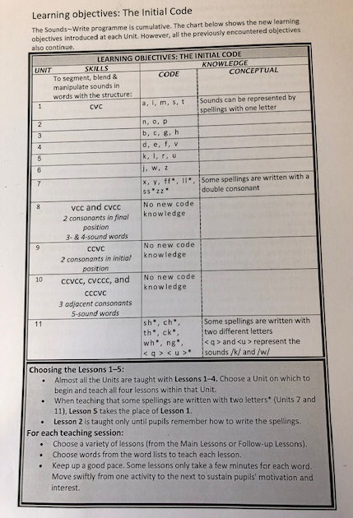
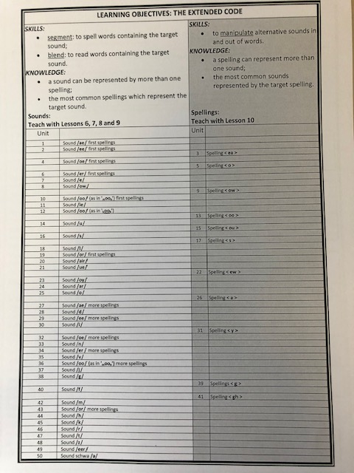

Slide 10
Reading at home
SKILLS
ENJOYMENT
Skills – your child will practice something they have learnt and should be able to do this fairly independently.
Enjoyment – you read a book to and with your child, you tell stories, they tell stories – a shared experience of reading!
Notes:
NOTE: To change images on this slide, select a picture and delete it. Then click the Insert Picture icon in the placeholder to insert your own image.

Slide 11
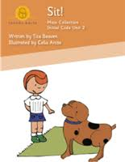
Reading Scheme – teaching tool
These things might start coming home
Sentences in WLS
Activity in WLS
Free Ebook shared by school
Free Kindle Edition book
OR a book for enjoyment
OR a book for your child to practise their reading skills
Reading a book for skill: https://www.youtube.com/watch?v=cXoNZoKWQu4&t=2s
Notes:
NOTE: To change images on this slide, select a picture and delete it. Then click the Insert Picture icon in the placeholder to insert your own image.

Slide 12
Reading Workshop
Any Questions?
Ideas for follow-up workshops?
Thank you for coming!

